Slide 1
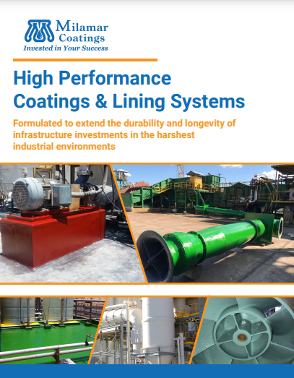
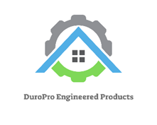

Slide 2
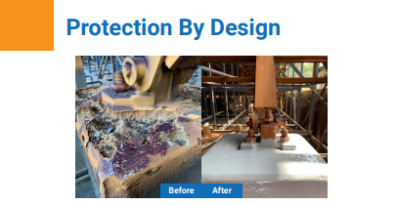
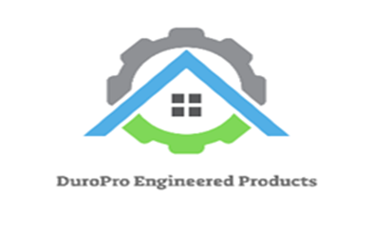
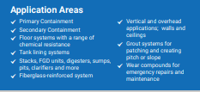
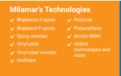
Chemistry Technologies
You play a critical role in mitigating health and safety risks for your employees and your community.
When protective coatings are under-specified for chemical exposure or other environmental factors,
corrosion and abrasion can reduce the lifespan and reliability of your structural investments. The
resulting downtime and repairs are costly for any facility. But in the chemical process industries,
deterioration can be hazardous to both human safety and the local environment.
Our mission is to “design-out” the causes of corrosion from day one.
At DuroPro,, our business is built upon the core belief that every facility, asset and situation is unique.
Based on our real-world experience solving corrosion problems in industrial facilities around the
globe, we know that it is not uncommon to identify exposure variables that differ widely among
identical assets within a single site. From “day one” our technical team collaborates directly with your
engineers to evaluate your functional requirements, range of exposures, installation schedule, budget,
regulatory requirements, and any other factors.

Slide 3
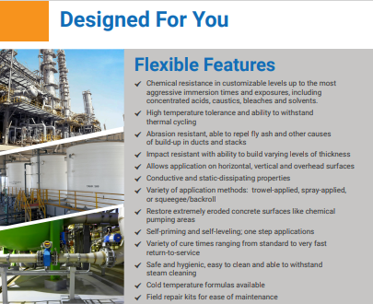

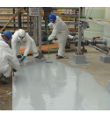
Expert Installation
DuroPro’s Certified Applicators are available to work 24 hours a day,
7 days a week, 365 days a year, during planned shutdowns and
unforeseen emergencies. They have labor and materials available at
a moment’s notice to minimize your production downtime. Perhaps
more importantly, they have the safety training, clearances, and
insurance to pre-qualify to work in challenging environments.
Whether you choose to use your own team or leverage our network
of installers, you can depend on our technical support and training in
all aspects of system installation, and we will teach your team the
proper maintenance techniques to protect your investment
WHEN YOU ARE READY FOR A TRUE SOLUTION TO THE PROBLEM

Slide 4
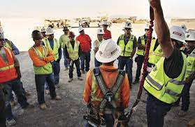
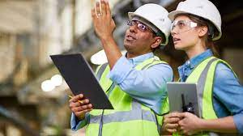
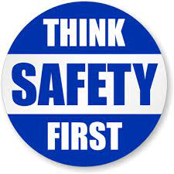

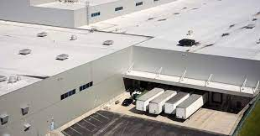

DuroPro Engineered Products
2252 N. 23rd Drive, Phoenix AZ 85009
602-739-3425
duroproengineeredproducts@gmail.com

